Slide 1
Lessons from building
a PWA
By
Robert James Gabriel

Slide 2

Name: Robert James Gabriel Age: 24 Position: Software Engineer at Teamwork.com
Tabs vs Spaces: Tabs. Github/Twitter: RobertJGabriel
Favourite Area: Web Apps and Machine Learning
Website: robertgabriel.ninja

Slide 3
“Progressive Web Apps blur the line between Web content and apps but they keep the strengths of the Web.”
Alex Russell
Technical Lead at Google for PWA’s

Slide 4

Progressive Web Apps are user experiences that have the reach of the web
Reliable - Load instantly even in uncertain network conditions.
Fast - Respond quickly to user interactions with silky smooth animations and no janky scrolling.
Engaging - Feel like a natural app on the device, with an immersive user experience.

Slide 5
Progressive
Responsive
Connectivity independent
App-like
FreshSafe
Discoverable
Reengage-able
Installable
Linkable
Notes:
Progressive - Work for every user, regardless of browser choice because they’re built with progressive enhancement as a core tenet.
Responsive - Fit any form factor: desktop, mobile, tablet, or forms yet to emerge.
Connectivity independent - Service workers allow work offline, or on low quality networks.
App-like - Feel like an app to the user with app-style interactions and navigation.
Fresh - Always up-to-date thanks to the service worker update process.
Safe - Served via HTTPS to prevent snooping and ensure content hasn’t been tampered with.
Discoverable - Are identifiable as “applications” thanks to W3C manifests[6] and service worker registration scope allowing search engines to find them.
Re-engageable - Make re-engagement easy through features like push notifications.
Installable - Allow users to “keep” apps they find most useful on their home screen without the hassle of an app store.
Linkable - Easily shared via a URL and do not require complex installation.

Slide 6
Manifest
{
"short_name": "Desk",
"name": "Teamwork Desk Login",
"background_color": "#fafafa",
"theme_color": "#65d656",
"display": "standalone",
"orientation": "portrait",
"scope": "./",
"gcm_user_visible_only": true,
"gcm_sender_id": "xxxxx",
"applicationServerKey":"",
],
"start_url": "https://walle.teamworkops.com/login",
"description": “"
"prefer_related_applications": true,
"related_applications": [
{
"platform": "play",
"id": "com.teamwork.mobile.desk"
}
]
}
Notes:
background_color
description
dir
display
icons
lang
name
orientation
prefer_related_applications
related_applications
scope
short_name
start_url
theme_color
Splash screens
Mime type
Specification
Browser compatibility

Slide 7
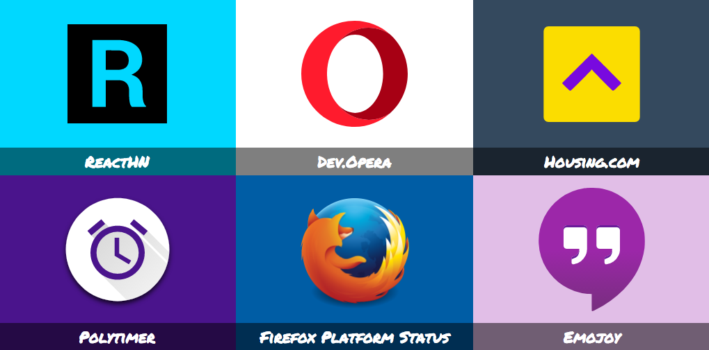
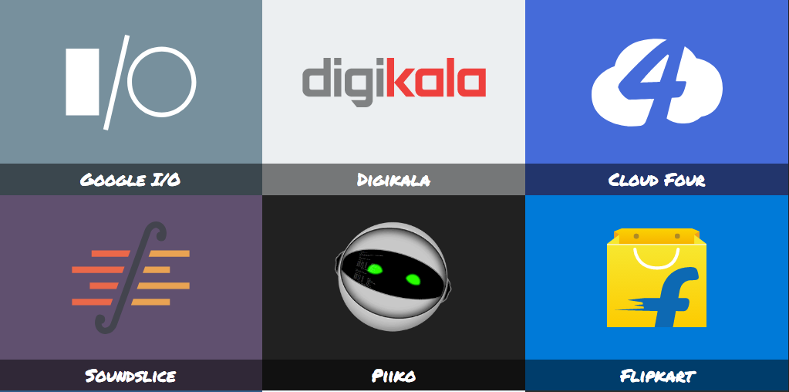
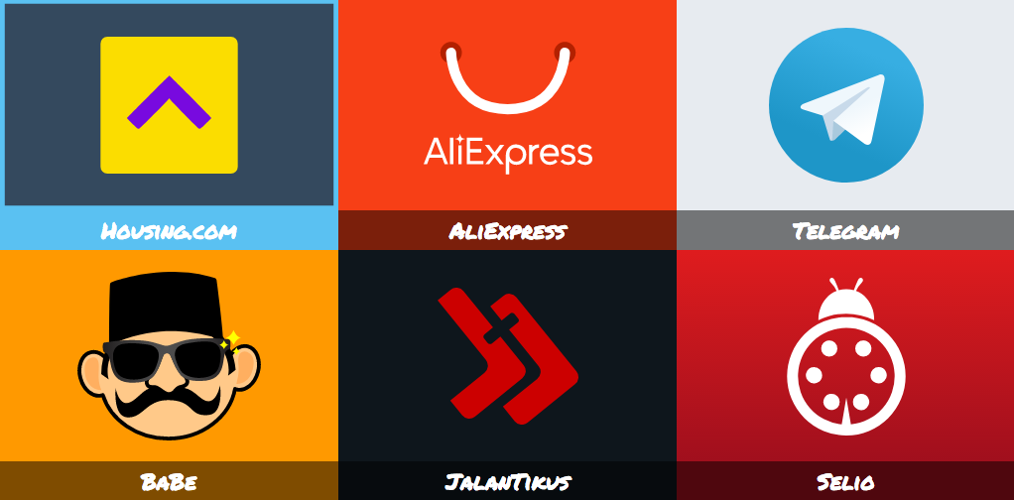
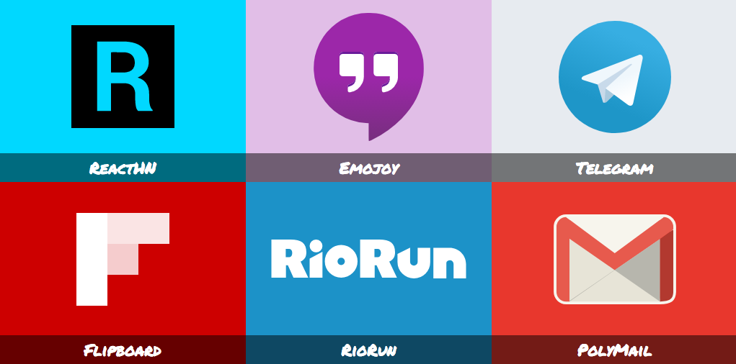
Notes:
Twitter Lite Code.nasa Teleagram Ploymail

Slide 8
Service Workers
“In short, a service worker is an asynchronous background thread that takes control of all network requests in a page, acting as a proxy.”
Notes:
The reason this is such an exciting API is that it allows you to support offline experiences, giving developers complete control over the experience.
Service workers make extensive use of promises, so if you're new to promises, then you should stop reading this and check out Promises, an introduction.
Full support being Chrome Edge Firefox Opera

Slide 9




Error
Terminated
No Service Worker
Installing
Activated
Idle
Fetch/Message
Notes:
The life cycle of a service worker. On the reload it checks if the cache is broke before it updates to a new one.

Slide 10



















Service Worker
Page
Network
3
1
X
Page
Cache
Cache
Service Worker
Service Worker
Cache
Page
X
4
2
Network
Page
Network
X
Service Worker
Notes:
1 Cache Only
2 Network Only
3 Cache, Falling Back To Network
4 Generic Fallback

Slide 11
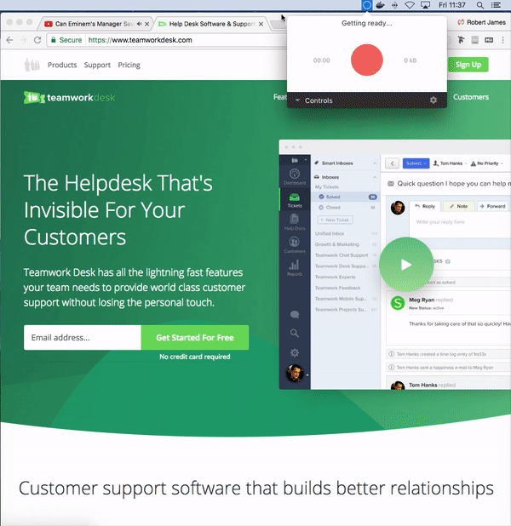
Works on HTTPS only, or localhost
Under Consideration in Safari, iOS
In Development in Microsoft Edge
Only One SW activated at a time
Should be on same origin
Has controlled scopes
Should be progressive
Doesn’t control origin page on first load
Run on background in a separate thread
Doesn’t have access to page DOM
Open tabs must be closed for old service workers to die
Use self.skipWaiting() with self.clients.claim()
Unregistering a SW doesn’t clear SW cache
Notes:
As you can see the speed of it on local online support.

Slide 12
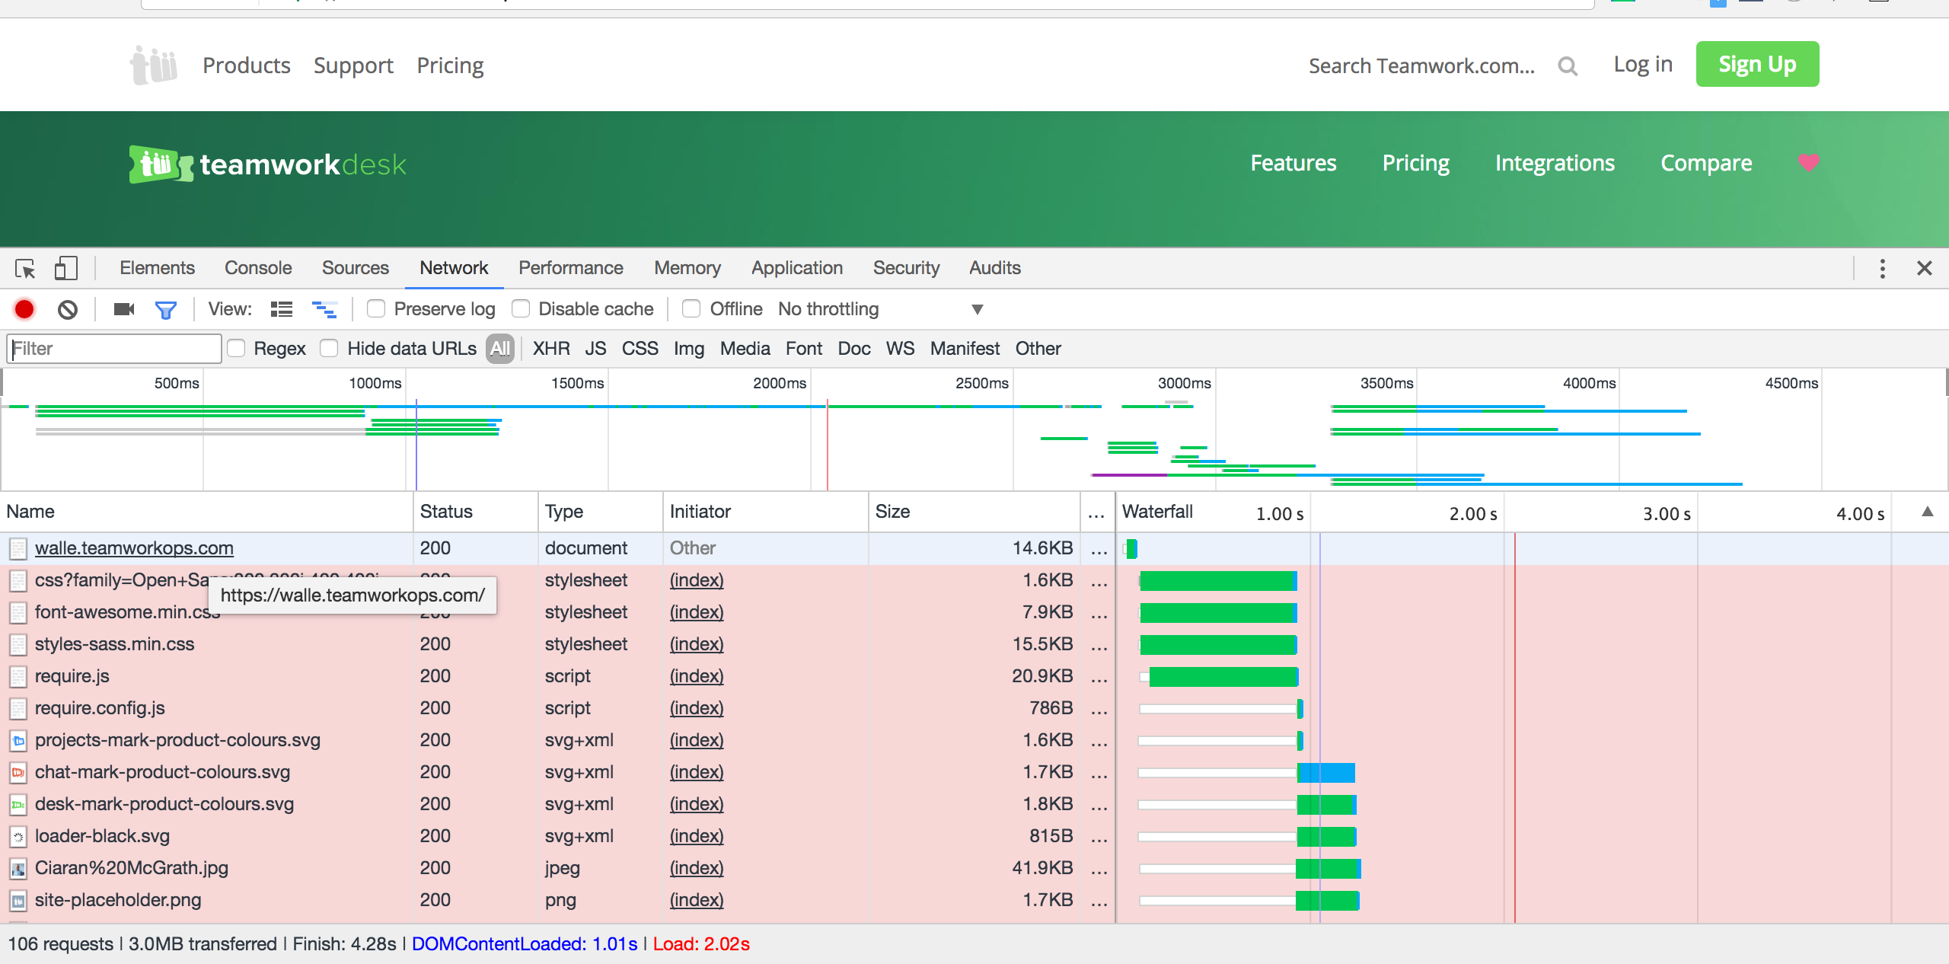
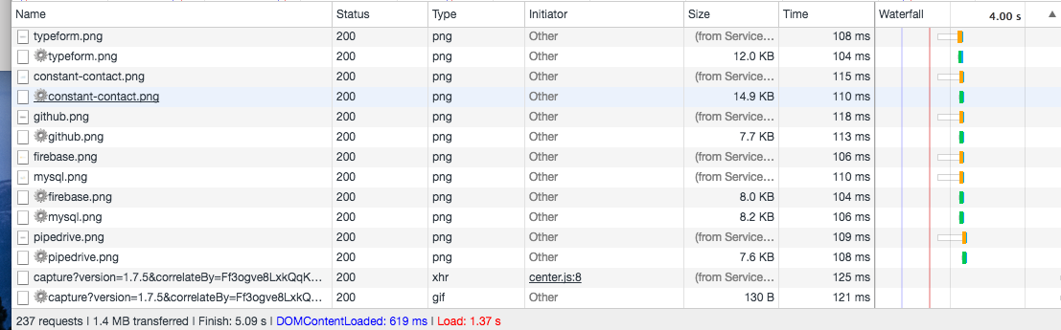
Requests 106 Transfer 3.0mb DomContent Loaded 1.01 Loaded: 2.02
Before
After
Requests 237 Transfer 1.4mb DomContent Loaded 619ms
Loaded: 1.37s

Slide 13
Lesson Learnt
Capability reporting
Client-side Load Balancer
Differential update of text files
Support a previous unsupported image format in your browser!
Great for finishing goals from GA.

Slide 14
Lighthouse
a tower or other structure tool containing a beacon light to warn or guide ships at seadevelopers.
Notes:
By running a set of tests, developers can discover new web platform APIs, become aware of performance pitfalls, and learn (newer) best practices. In other words, do better on the web!

Slide 16
What it tests for?
App can load on offline/flaky connections
Site is progressively enhanced
Page load performance is fast
Address Bar Matches Brand Colours
Avoids Application Cache
Avoids console.time() In Its Own Scripts
Avoids Date.now() In Its Own Scripts
Avoids document.write()
Avoids Requesting The Geolocation Permission On Page Load
Uses Passive Event Listeners to Improve Scrolling Performance
Uses HTTPS
Unoptimised Images
Avoids Web SQL
Background and Foreground Colours Have Sufficient Contrast Ratio
Buttons Have An Accessible Name
Avoids Mutation Events In Its Own Scripts
Avoids Old CSS Flexbox
Notes:
2 : Progressive enhancement means that everyone can access the basic content and functionality of a page in any browser, and those without certain browser features may receive a reduced but still functional experience.

Slide 17
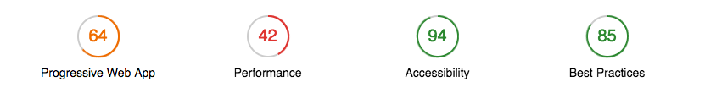
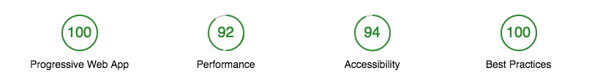
Before
After

Slide 18
Lesson Learnt
You can use the official chrome extension to try in app and by pass login.
Images will lower your score. Theres a github bot for pull requests Its a guide not a set of rules.
Notes:
2 : Progressive enhancement means that everyone can access the basic content and functionality of a page in any browser, and those without certain browser features may receive a reduced but still functional experience.

Slide 19
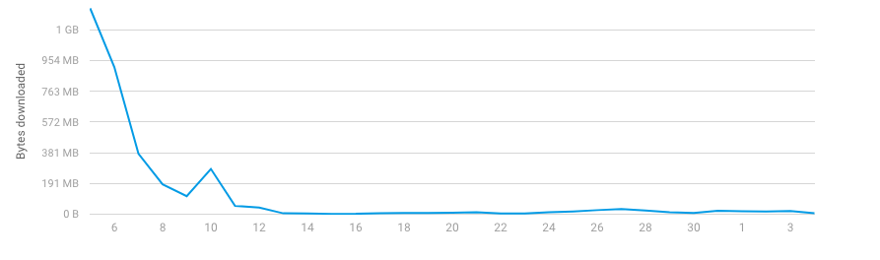
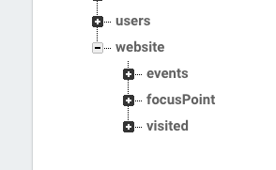
Firebase
userTable.orderByChild('fingerPrintId').equalTo(fingerPrintId).once 'value', (snapshot) =>
userData = snapshot.val()
if userData
firebaseUserKey = Object.keys(snapshot.val())[0]
data =
lastVisitTime: app.utility.getTime()
lastVisitDate: app.utility.getDate()
@updateUser(data,firebaseUserKey)
else
@setUser(fingerPrintId)
return
Notes:
2 : Progressive enhancement means that everyone can access the basic content and functionality of a page in any browser, and those without certain browser features may receive a reduced but still functional experience.

Slide 20
Jumia sees 33% increase in conversion rate, 12X more users on PWA
33% higher conversion rate 50% lower bounce rate 12X more users versus native apps (Android & IOS)
5X less data used 2X less data to complete first transaction. 25X less device storage required
Notes:
Jumia, a leading e-commerce website in Africa, showcased their Progressive Web App (PWA) journey in 2016, outlining how they delivered an app-like experience to users through modern web capabilities. PWA has since proved to be far more than a buzzword—it’s now the de facto way Jumia builds for mobile devices. They’ve integrated PWA across many of their operations, including Jumia Travel.
•

Slide 21
So Far
Time on page up 5.8%.
2X less data used
1.3X less data to complete first transaction.
Sessions up 4.6%.
Users up 3.1%
60% of signups follow Teamwork Desk landing page, Integrations then signup.

Slide 22

You can see everything in more detail at robertgabriel.ninja/pwa
Thank You

